Slide 1
Train and Give Inputs to a Machine Learning Model
BY: Samiya Sadiq
samiyasadiq2002@gmail.com

Slide 2
INTRODUCTION
TRAINING OUR MODEL USING LINEAR REGRESSION
GIVING INPUT TO THE MODEL
AGENDA

Slide 3
INTRODUCTION
In this task, we are required to train a model and give inputs to them. Here, we will be using Linear Regression which is a type of supervised machine learning algorithm. Linear regression performs the task to predict a dependent variable value (y) based on a given independent variable (x)). Hence, the name is Linear Regression.
1. x: input training data
2. y: labels to data (Supervised learning) When training the model – it fits the best line to predict the value of y for a given value of x.
3. The model gets the best regression fit line by finding the best a and b values where a is the intercept and b is the coefficient of x. Once we find the best a and b values, we get the best-fit line. So when we are finally using our model for prediction, it will predict the value of y for the input value of x
y= a + bx

Slide 4
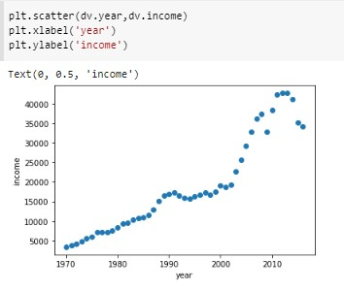
Training and Implementation Of Linear Regression
We are using a dataset called Canada per capita income, which consists of two attributes year and per capita income(US$). We will be predicting the per capita income using linear regression. We will plot the given year and per capita income in the form of a scattered plot as shown below.
We need to get the line which best fits these data points. Once we get the best-fit line we can make predictions

Slide 5
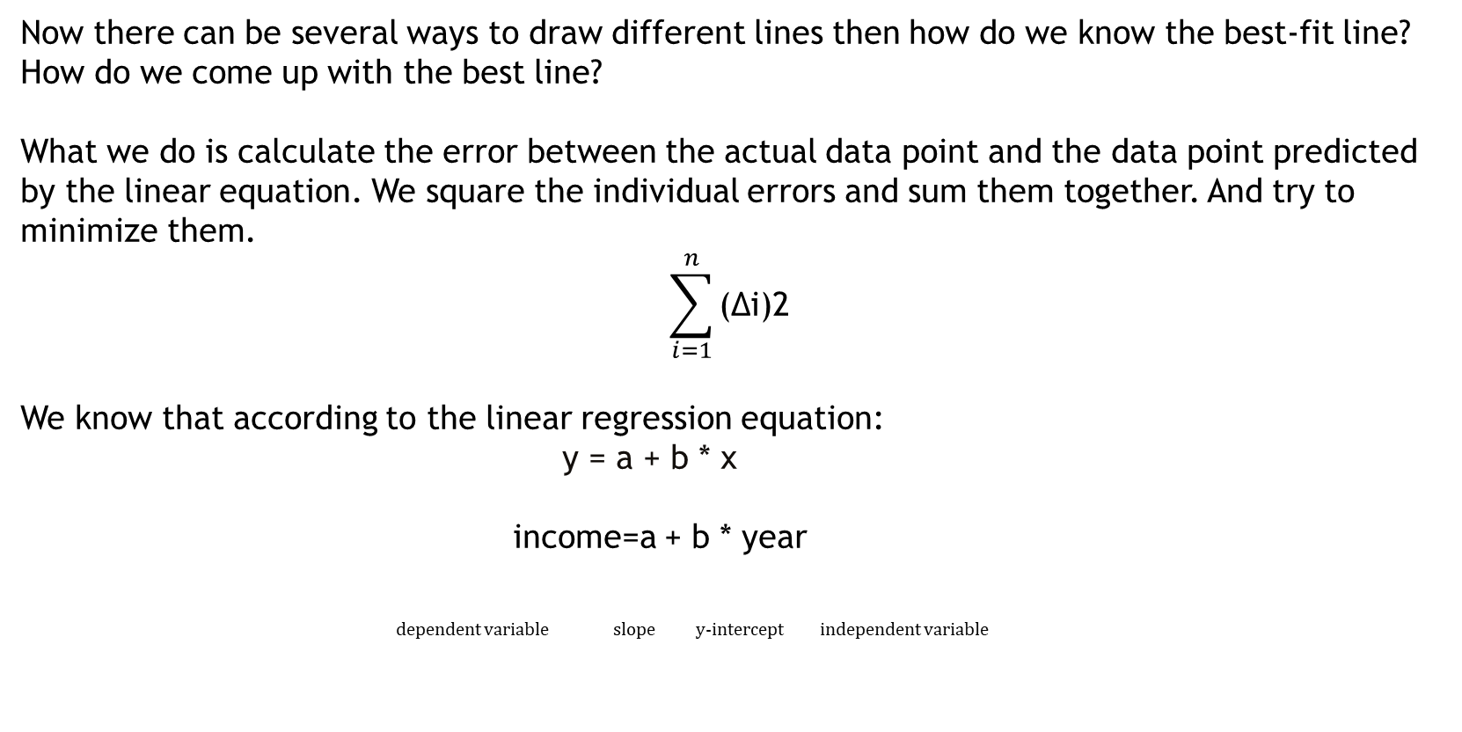
Now there can be several ways to draw different lines then how do we know the best-fit line?
How do we come up with the best line?
What we do is calculate the error between the actual data point and the data point predicted by the linear equation. We square the individual errors and sum them together. And try to minimize them.
$$\sum_{i=1}^{n}{\text{(∆}\text{i}\text{)2 }}$$
We know that according to the linear regression equation:
y = a + b * x
income=a + b * year
dependent variable slope y-intercept independent variable

Slide 6
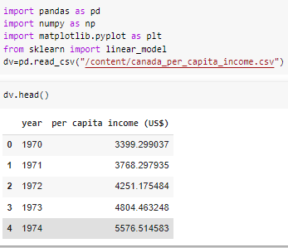
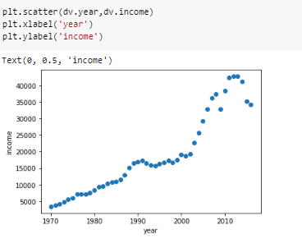

1. Reading our dataset and importing relevant modules or libraries:
2. Renaming per capita income(US$) to income
3. Plot scattered plot of income and year:
4. Now, splitting data into testing and training with a test size of 0.2 (x is year and y is income)

Slide 7

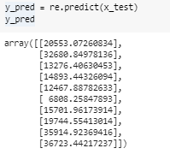
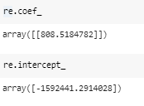
5. Now, create an object of linear regression and then fit the data (fitting the data is nothing but we are training our linear regression model using the available data points)
6. Generating predictions for our model
7. Printing coefficient and intercept

Slide 8
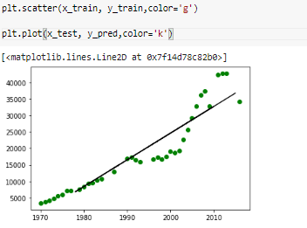

These are the intercept and coefficient of the best line for the given data points.
8. Plotting the regression line
Now, as our model is ready we are ready to make predictions.

Slide 9
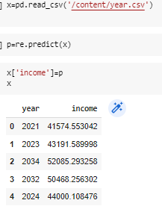

Giving inputs to the trained model
Now we will test the performance of the model by giving inputs to the model based on the features they used to train it. It is important to test our model by giving inputs. We will provide a year dataset and predict the per capita income for it. Here we will use model.predict() to make prediction for given input. The input is given to model.predict() to predict
We can also create a NumPy array, where you have to input the values of the features you used to train your machine learning model.

Slide 10

LINKS:
Dataset
Github
sklearn.linear_model.LinearRegression

